Slide 1

“CLOUD COMPUTING BASED E-LEARNING WEB APPLICATION SYSTEM”
PROJECT BY,
MOHANA PRIYA.J - 192210177
SRILATHA.P - 192210173
ABINAYA K - 192211931
PROJECT GUIDE,
MADHUSUNDAR

Slide 2

abstract
To offer flexible learning possibilities in degree and continuing education and also in lifelong learning. To decrease the proportion of lectures and increase the proportion of individual work in the study process.
Web-based learning enables us to offer alternative learning possibilities for people with special needs, from remote areas, women with small children, full-time workers, and Estonians living abroad.

Slide 3
INTRODUCTION
E-learning includes all forms of electronically supported learning and teaching. This often in-classroom educational experiences via technology.
CBT (Computer-Based Training), IBT (Internet-Based Training), or WBT (Web-Based Training) have been used as synonyms to eLearning.
E-learning can take various forms, including online courses, webinars, virtual classrooms, interactive multimedia modules, and digital simulations.It is commonly thought that new technologies can make a big difference in education.
Cloud computing is a term referred to as storing and accessing data over the internet globally. It is a popular option for people and businesses for several reasons including cost savings, increased productivity, speed, and efficiency, performance, reliability, and security

Slide 4
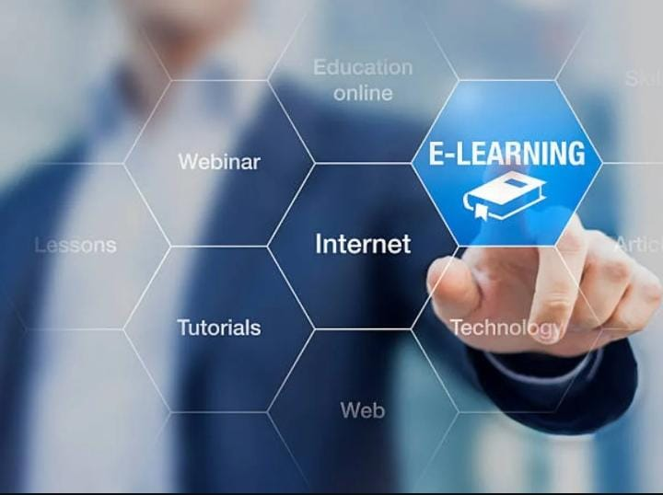
OBJECTIVES
E-Learning is essential in current trends and combining eLearning with Cloud computing gives more benefits.
Cloud computing delivers services autonomously based on demand and provides sufficient network access, data resource environment, and flexibility by keeping this point in view, implementation of the system will be done.

Slide 5
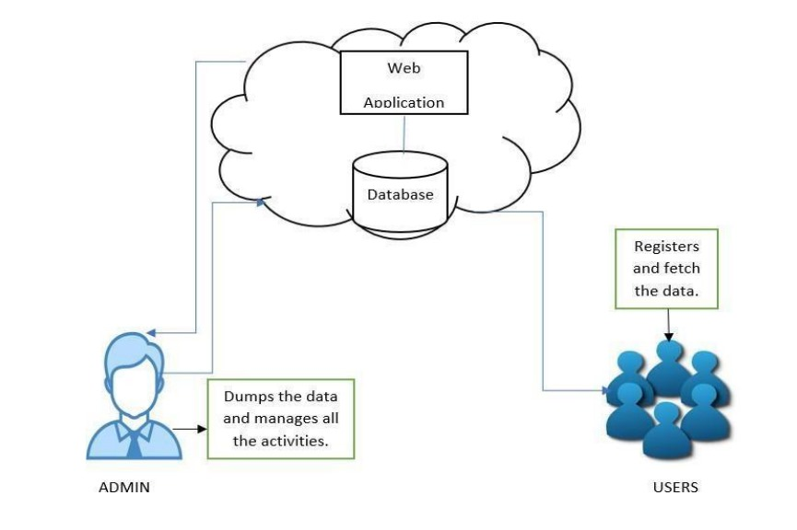
PROPOSED SYSTEM
The architecture diagram shows the overall flow of the proposed E-Learning System. There will be admin and user.
Admin can dump the data in web application and manages, controls all the activities of the application.
The user has to register in the web application ad fetch, view data that was added by the admin. The web application is hosted in the cloud server. Adding and fetching information by admin and user is done by using MySQL.
It has improved the proper security of data and it provides better service for the users.

Slide 6
SYSTEM DESIGN & METHODOLOGY
The implementation deals with the tools that have used to design the webpage and also the methods how it was implemented for connecting back-end servers.Wordpress is used to create front-end page. The other tools which have used are google firebase,cloudfare,adobe photoshop.
WHY WORDPRESS AND GOOGLE FIREBASE?
Here we used wordpress because it doesn’t require any coding and it saves a lot of time.
Firebase for authentication purposes like authenticating and validating the users mobile number while creating their account finally to secure our website,to get certificate from cloudfare.
WORDPRESS:
WordPress is web publishing software that can be used to create the website. WordPress enables to build and manage full-featured website using web browser without learning how to code.
GOOGLE FIREBASE :
Google Firebase Authentication creates the task easy for developers to build secure authentication systems and enhances the sign-in experience for users. This feature offers a complete identity solution, supporting email and password accounts, phone authentication.
ADOBE PHOTOSHOP
To get certificate for completion.

Slide 7
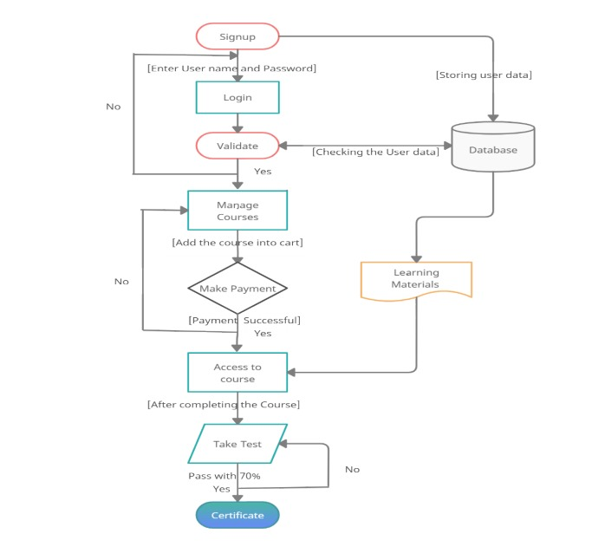
IMPLEMENTATION
A user has to Sign up with the username and password and. once you submit your details it will store them in the database. If the details provided by you are correct then you can move further.
Further user can view all the courses which are available and select one of their choices and continue for payment. if payment is not successful user needs to check it and pay then only the course will be unlocked.
After completing all the modules in the course then the user has to take up a quiz if they pass with 70%, they will receive a certificate of completion and if they fail then they have to take up the quiz again.

Slide 8
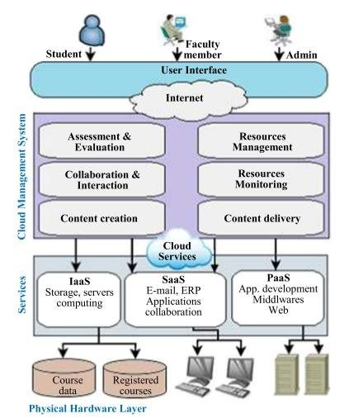
SERVICE LAYERS
Three levels of services in cloud computing are SaaS, PaaS, IaaS.
In SaaS:
Use software via the Internet
Not to need a one-time purchase for software and hardware
Not to need to maintain and upgradeOnly paying a monthly fee
In PaaS:
Secondary development skill is offered for users.
Location based interface developed can be used by third parties.
In IaaS:
Products offers via this mode include remote delivery (through the Internet) of a full computer infrastructure.

Slide 9

RESULT
The cloud-based e-learning web application system to revolutionize the way education is delivered and accessed. The platform will provide a scalable, accessible, and collaborative learning environment for students and instructors.
Ultimately, the cloud-based e-learning web application system project seeks to transform traditional educational practices and empower learners to succeed in the digital age.

Slide 10

CONCLUSION
Cloud computing-based E‐ learning web application system is the latest generation of traditional e-learning. This e-learning web application system allows to exchange of the form of education content and integrate new learning methods.
Mainly to reduce costs and maintain training. This e-learning application based on the cloud is created for mass data storage, high-speed computing capabilities, and its ideal allocation and sharing mode of resources.
Cloud services are rising rapidly that makes the changes in information technology. These Cloud services are now available for all students and teachers. By using cloud computing they can access anywhere, anytime, and on any device.

Slide 11
REFERENCE
M. Britt, "How to better engage online students with online strategies," College Student Journal, vol. 49, pp. 399-404, 2015.
C. Lee. (2016, Handbook of Research on Cloud-Based STEM Education for Improved Learning Outcomes. IGI Global.
M. A. H. Masud and X. Huang, "An e-learning system architecture based on cloud computing," system, vol. 10, 2012.
S. Vitkar, "Cloud-based model for e-learning in higher education, “International Journal of Advanced Engineering Technology, vol. 3, pp. 38-42, 2012.
M. A. H. Masud and X. Huang, "A novel approach for adopting cloud-based e-learning system," in Computer and Information Science (ICIS), 2012 IEEE/ACIS 11th International Conference on, 2012, pp. 37-42.

Slide 12

THANK YOU

